Slide 1

CSCI331- Project 3: Group 8
Sharlene Zar, Matin Nazamy, Humaira Qadeer, Steven Necola, Ensar Dogrusoz, Luis Diaz

Slide 2

Organization

Slide 3
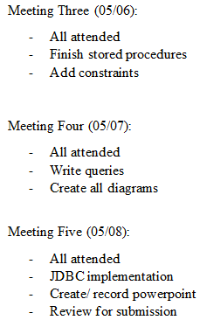
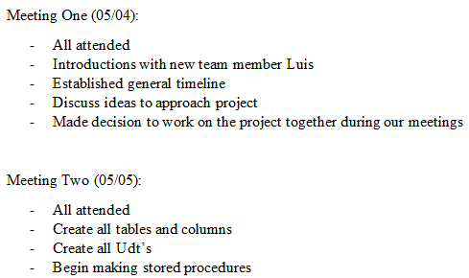
Meeting Notes

Slide 4
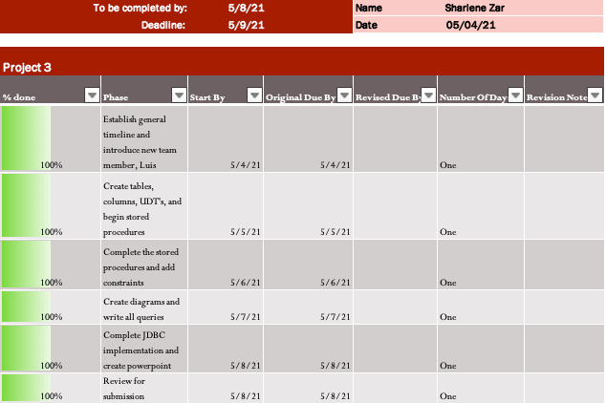
To Do: Sharlene

Slide 5
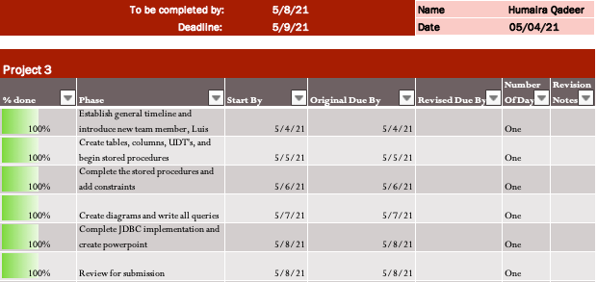
To Do: Humaira

Slide 6

To Do: Matin

Slide 7
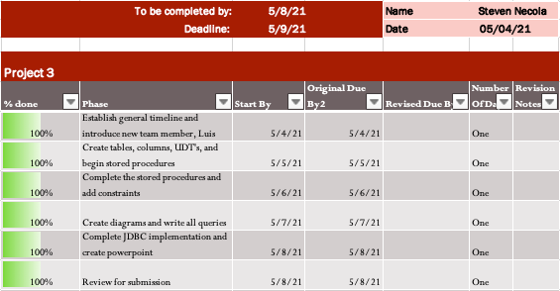
To Do: Steven

Slide 8
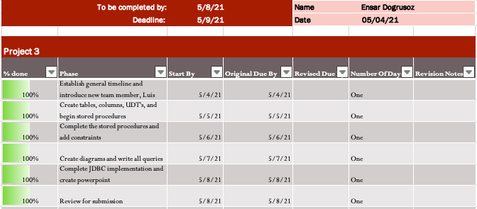
To Do: Ensar

Slide 9
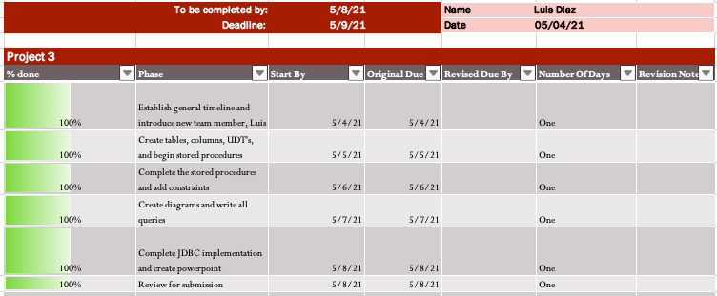
To Do: Luis

Slide 10
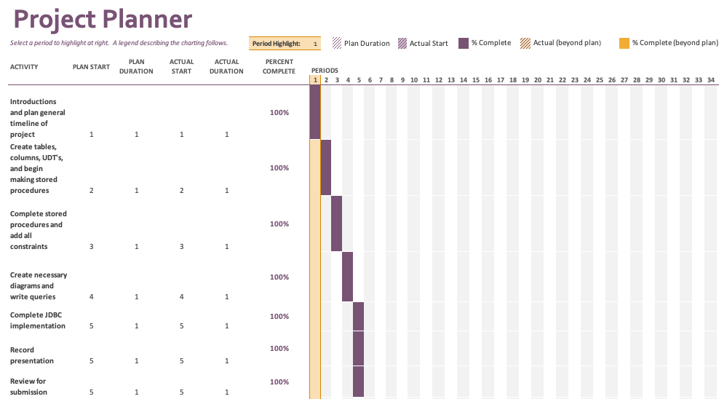
Gantt Project Planner

Slide 11

Part One: Runthrough of database

Slide 12
Data Cleansing Issues: Anomalies
Some data cleansing issues we fixed:
Float data type for class hours with decimals (.5, 1.5, etc.)
Fixed and acknowledged null start times, instructors, end times, buildings and rooms, etc.
Fixed issues with online courses taking up building slots.
Fixed issues with professors being duplicated for the same course.
Notes:
Matin

Slide 13
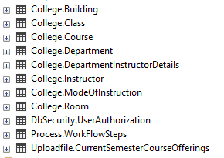
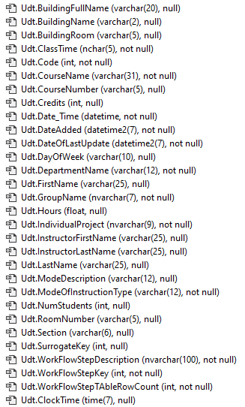
Naming Conventions
All table names are Pascal Case and Singular (Room, Instructor, Course, Class, Department, Building, ModeOfInstruction and DepartmentInstructorDetails).
User Defined Types are also (Except Date_Time) Pascal case and singular. They are modeled after the columns they’re to be used for, allow for easy and robust relations between tables, and account for edge cases in data entry to avoid any errors in insertion.
Notes:
Ensar

Slide 14
Hierarchy & Re-use of UDT’s
We re-used the SurrogateKey UDT for every identifying column int (which was also defaulted by a sequence object), and the Date_Time UDT for every table’s DateAdded and DateUpdated column.
We also have Weak and Strong Entities in their Physical forms with the Instructor and Department tables being Strong Entities and the InstructorDepartmentDetails being a bridge table between the two previous tables as a Weak Entity to normalize our schema.
Notes:
Steven

Slide 15
Constraints
We created foreign key relationships between essentially all tables in the College schema.
Then we created procedures to add and drop the foreign key constraints throughout the schema.
Secondly, all identifiers, primary or otherwise, are guaranteed to be unique thanks to the PkSequence objects they default to.
We have non-negativity constraints on all Surrogate keys.
Notes:
Humaira

Slide 16
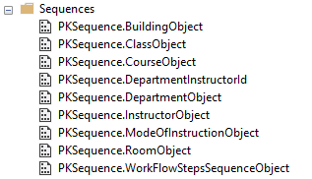
Index Design Decisions
We decided to make a sequence object as the index for every table.
Each table defaults to a non-negative sequence to use as the key to save on memory in tables where a classname, description, etc. is not needed but can easily be accessed in views through joins.
Notes:
Humaira

Slide 17
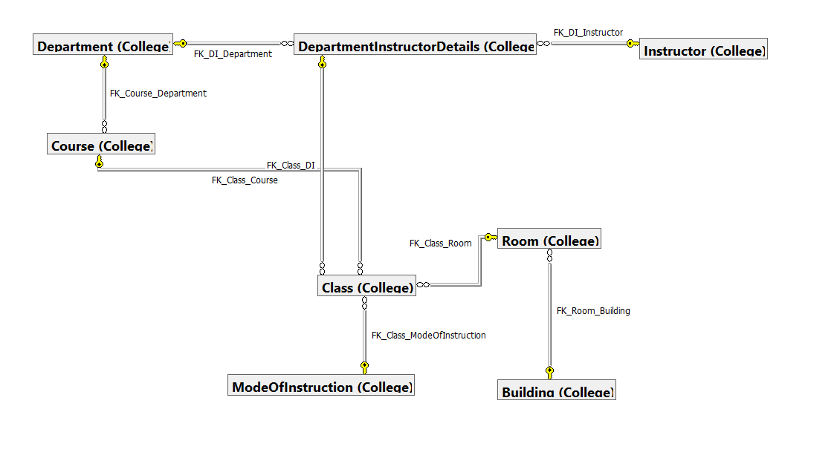
Conceptual Data Model (CDM)
Notes:
Class table has a child relationship to multiple parent tables including the course table on the courseid, departmentinstructordetails table for the departmentinstructorid , room table for the roomid and modeofinstruction table for the modeofinstructionid. Steven
Course table has a child relationship to parent table department to find related departments
Departmentinstructordetails table has a child relationship to parent tables department for the departmentid and instructor for instructor id to relate instructors to their departments
Room table has a child relationship to parent table building for roomid to relate rooms with their buildings

Slide 18
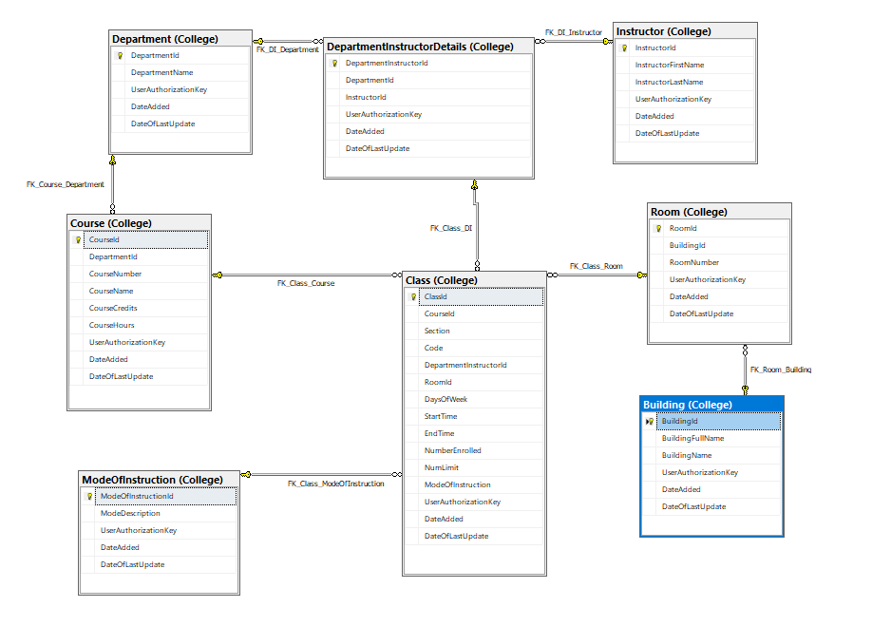
Logical Data Model (LDM)
Notes:
Steven

Slide 19
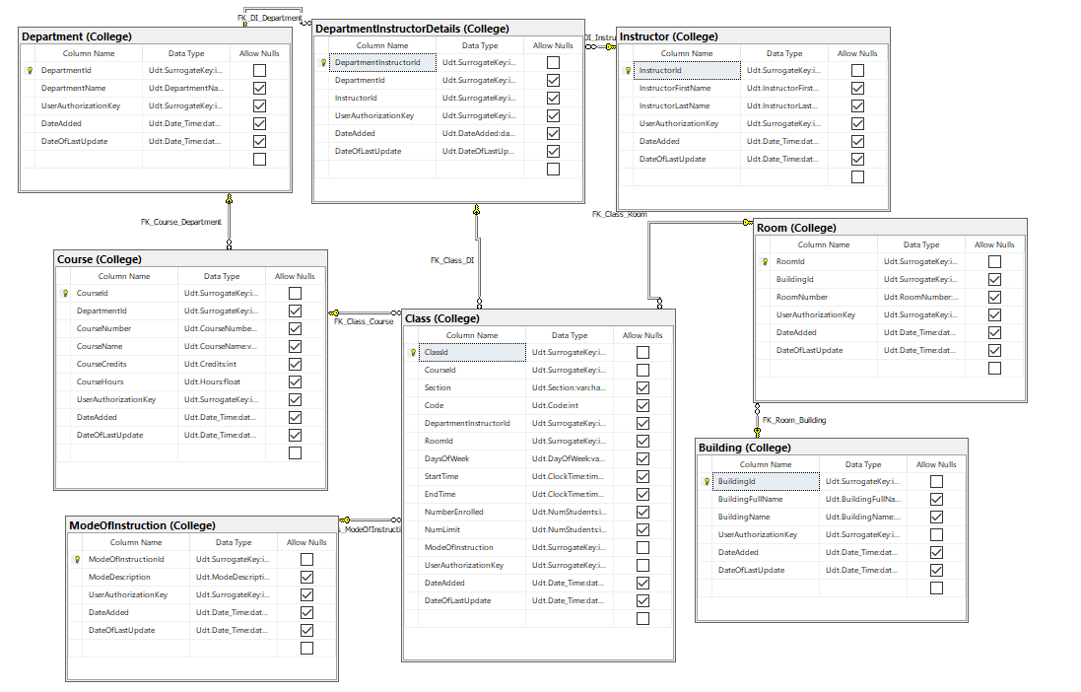
Physical Data Model (PDM)
Notes:
Isolate table and foreign key relationships in subject areas
Show UDT’s
Steven

Slide 20
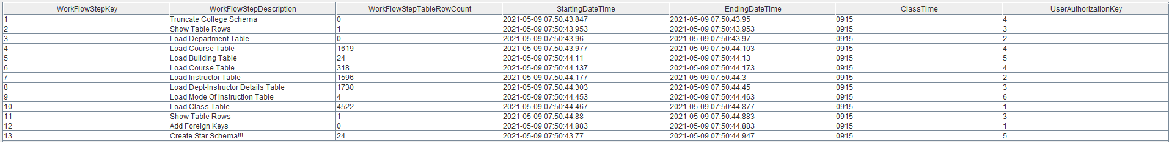
Process.WorkflowSteps Output
Notes:
Sharlene

Slide 21

Redgate Acknowledgement
Notes:
Matin

